Slide 1
Introduction to Consumer Behaviour
Module-1

Slide 2
Learning Objectives
1. Define consumer behavior and explain the components that make up the definition
2. Identify the four domains of consumer behavior
3. Discuss the benefits of studying consumer behavior
4. Explain how companies apply consumer behavior concepts when making marketing decisions

Slide 3
Consumer Behavior
Acquisition, consumption, and disposition of goods, services, time, and ideas by human decision-making units
  Acquisition: Consumer comes to own an offering
  Usage: Consumer uses an offering
  Disposition: Consumer discards an offering
How does this relate to marketing strategies and tactics?

Slide 4
Consumer Behavior (continued 1)
Dynamic process
Can involve many people
Involves many decisions
Involves consumer emotions and coping

Slide 5
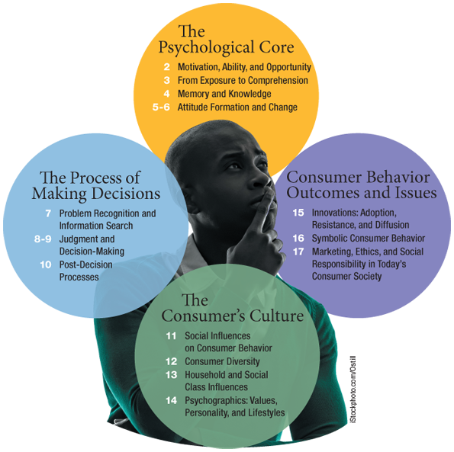

Slide 6
Beneficiaries of Consumer Behavior Studies
Marketing managers
Ethicists and advocacy groups
Public policy makers and regulators
Academics
Consumers
Marketing : Activity, set of institutions, and processes for creating, communicating, delivering, and exchanging offerings that have value
Aimed at individuals, groups, and society

Slide 7
Marketing Implications of Consumer Behavior
Developing or implementing customer-oriented strategy
  Segmentation of the market
  Profitability of each segment
  Characteristics of consumers in each segment
  Customer satisfaction with existing offerings
Selecting target market

Slide 8
Marketing Implications of Consumer Behavior (continued 1)
Developing products
  Consumer ideas for new products
  Attributes that can be added or changed in existing products
  Branding of offering
  Appearance of package and logo

Slide 9
Marketing Implications of Consumer Behavior (continued 2)
Positioning decisions
  Positioning of competitive offerings
  Positioning of one’s own offerings
  Need for repositioning offerings

Slide 10
Marketing Implications of Consumer Behavior (continued 3)
Promotion and marketing communication decisions
  Communication objectives
  Appearance of marketing communications
  Location, time, and effectiveness of advertisement
  Sales promotion objectives and tactics
  Effectiveness of sales promotion
  Number of sales personnel required to best serve customers

Slide 11
Marketing Implications of Consumer Behavior (continued 4)
Pricing decisions
  Price range of a product or service
  Consumer sensitivity to price and price changes
  Pricing tactics be used
Distribution decisions
  Time and convenience of consumers
  Assortment of merchandise
  Store design

Slide 12
